Slide 1
Summer Term 22 Multi-Agent Reinforcement Learning for Self-Adaptive Systems Lecture-6: Transfer Learning in Multi-Agent RL (Overview)
Prof. Dr. Holger Giese (holger.giese@hpi.uni-potsdam.de)
Christian Medeiros Adriano (christian.adriano@hpi.de) - “Chris”
He Xu (he.xu@hpi.de)

Slide 2
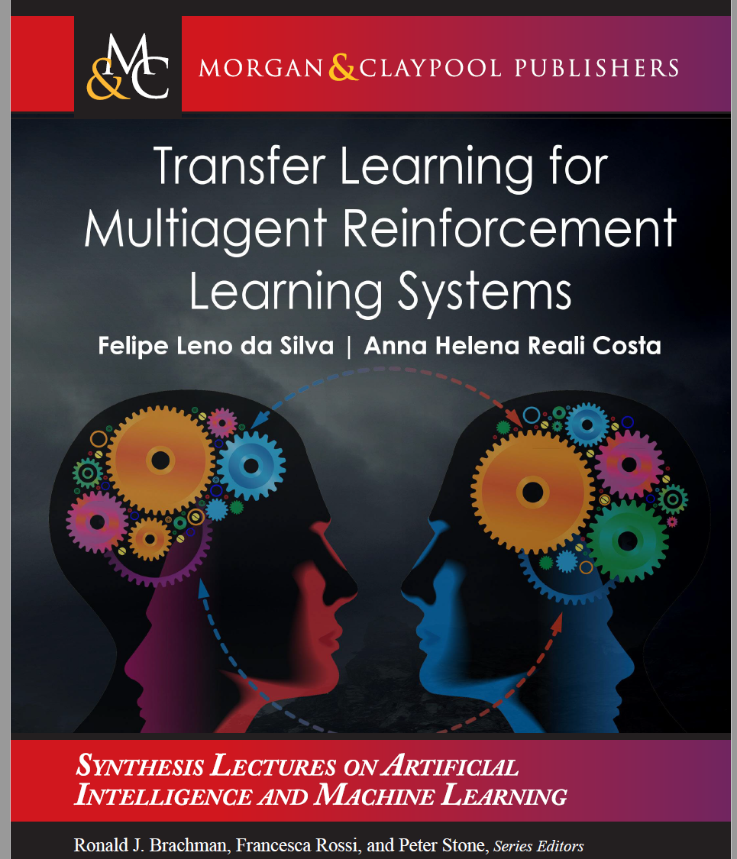
Transfer Learning in MARL – Wednesday May 18
Surveys
Zhu, Z., et al., 2020, Transfer learning in deep reinforcement learning: A survey. arXiv:2009.07888.
Silva, F. L. da & Costa, A. H. R., 2021, Transfer learning for multiagent reinforcement learning systems. Synthesis Lectures on Artificial Intelligence and Machine Learning 15.3, pp.1-129.
Herrera, Manuel, et al., 2020, Multi-agent systems and complex networks: Review and applications in systems engineering. Processes 8.3, 312
Cheng, Z., et al., 2021, Multi‐agent reinforcement learning via knowledge transfer with differentially private noise. International Journal of Intelligent Systems 37.1, pp.799-828.
Christianos, P., et al., 2020, Shared experience actor-critic for multi-agent reinforcement learning. arXiv:2006.07169.
Grimbly, St. , et al., 2021. Causal multi-agent reinforcement learning: review and open problems. arXiv:2111.06721.
Yang, T., et al., 2020, Transfer among agents: an efficient multiagent transfer learning framework. arXiv:2002.08030.
Applications

Slide 3
Topics related to transfer learning
Imitation learning [Ho 2016,Kostriov 2018]
What: learns a policy by mimicking the behavior of an expert policy
Why: when the environment feedbacks are partially or not available
Lifelong learning/Continual learning [Al-Shedivat 2018, Chen 2020]
What: learns spatio-temporal related tasks
Why: dynamically-changing tasks (non-stationarity)
Hierarchical/Feudal Reinforcement learning [Al-Emran 2015, Pateria 2021]
What: learns hierarchical tasks (e.g., robotics)
Why: state-space is partitioned in different granularities
Multi-Agent Reinforcement learning [Gronauer 2021, Zhang 2021]
What: learns to solve sequential decision problems that a single agent cannot
Why: need for multiple agents because of scalability or conflicting goals
Challenge: learn with sparse data, few demonstrations or reward signals
Challenge: acquire new information while retaining previous knowledge across new detected tasks
Challenge: decompose goals and task, while doing proper credit assignment
Challenge: coordination and knowledge sharing among agents
Ho, J. & Ermon, S., 2016, Generative adversarial imitation learning, NeurIPS
Kostrikov, I., et al, 2018, Discriminator-actor-critic: Addressing sample inefficiency and reward bias in adversarial imitation learning
Chen, Z., & Liu, B., 2018, Lifelong machine learning. Synthesis Lectures on Artificial Intelligence and Machine Learning
Al-Shedivat, M., et al, 2018, Continuous adaptation via meta-learning in nonstationary and competitive environments, ICLR
Pateria, S., et al., 2021, Hierarchical reinforcement learning: A comprehensive survey. ACM Computing Surveys (CSUR) 54.5
Al-Emran, M., 2015, Hierarchical reinforcement learning: a survey. International journal of computing and digital systems, 4(02).
Gronauer, S. & Diepold, K., 2021, Multi-agent deep reinforcement learning: a survey. Artificial Intelligence Review
Zhang, K., et al., 2021, Multi-agent reinforcement learning: A selective overview of theories and algorithms. Handbook of Reinforcement Learning and Control
Notes:
Lifelong Learning challenge is to make tradeoffs between acquiring new information and retaining the previously learned knowledge across new tasks.
J. Ho and S. Ermon, “Generative adversarial imitation learning,” NeurIPS, 2016.

Slide 4
Learning Approaches [Zhu 2022]
Which knowledge is transferred?
Data (source experiences and trajectories)
Model dynamics (MDP and laws that govern the environment)
Policies (action probability distribution of source or expert policy)
Value-functions (quality of state and action pairs in the source or target MDP)
Which RL frameworks are compatible with the transfer learning approach?
What is the difference between the source and the target domain?
What information is available in the target domain?
How sample-efficient the transfer learning approach is?
What are the goals of transfer learning?
source: Zhu, Z., et al., 2022, Transfer Learning in Deep Reinforcement Learning: A Survey

Slide 5
Evaluation Metrics [Zhu 2022]
Jumpstart performance (jp): the initial performance of the agents.
Asymptotic performance (ap): the ultimate performance of the agents.
Accumulated rewards (ar): the area under the learning curve of the agents.
Transfer ratio (tr): the ratio between asymptotic performance of the agents with transfer learning and asymptotic performance of the agents without transfer learning.
Time to threshold (tt): the learning time (iterations) needed for the target agents to reach certain performance threshold.
Performance with fixed training epochs (pe): the performance achieved by the target agents after a specific number of training iterations.
Performance sensitivity (ps): the variance in returns using different hyper-parameter settings.
source: Zhu, Z., et al., 2022, Transfer Learning in Deep Reinforcement Learning: A Survey

Slide 6
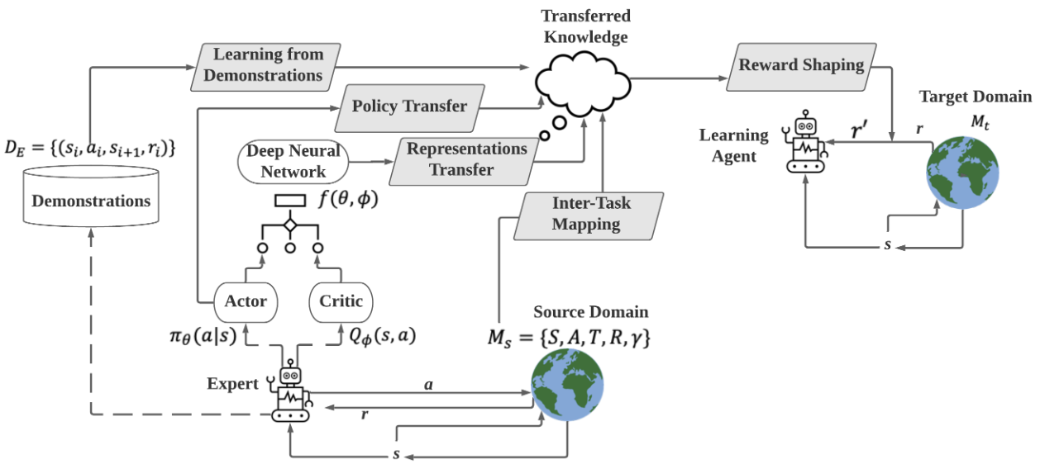
Approaches to Transfer Knowledge [Zhu 2022]
source: Zhu, Z., et al., 2022, Transfer Learning in Deep Reinforcement Learning: A Survey

Slide 7
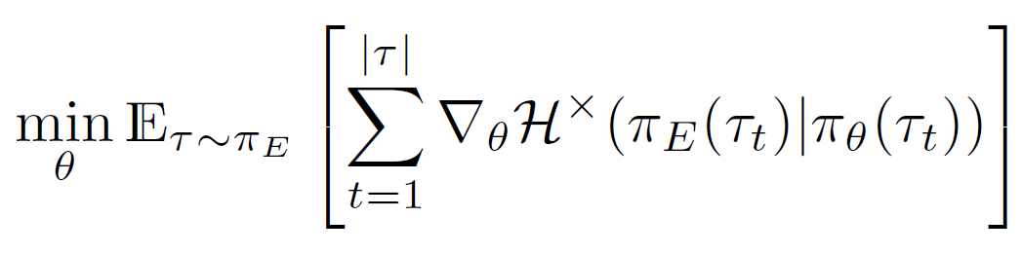
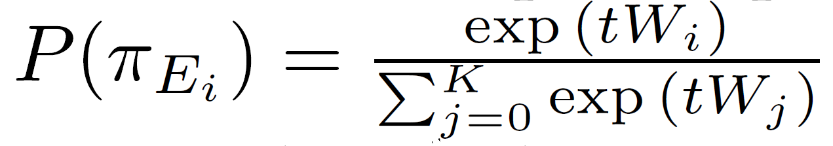
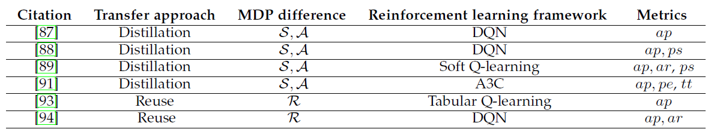
Policy Transfer [Zhu 2022]
Policy Distillation - minimizes the divergence of action distributions between the teacher policy and student policy
Policy Reuse - learns the target policy as a weighted combination of different source-domain policies, where weights are based on the expected performance gain in the target domain.
source: Zhu, Z., et al., 2022, Transfer Learning in Deep Reinforcement Learning: A Survey

Slide 8
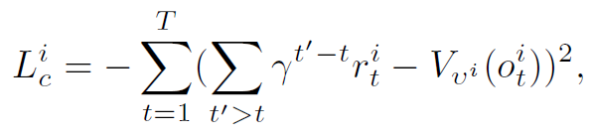
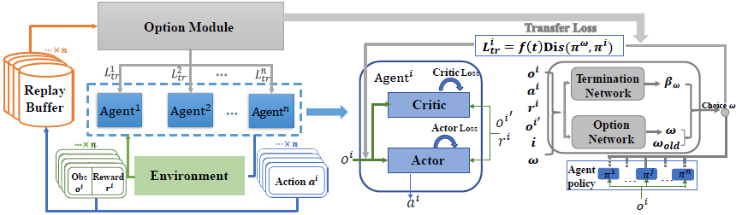
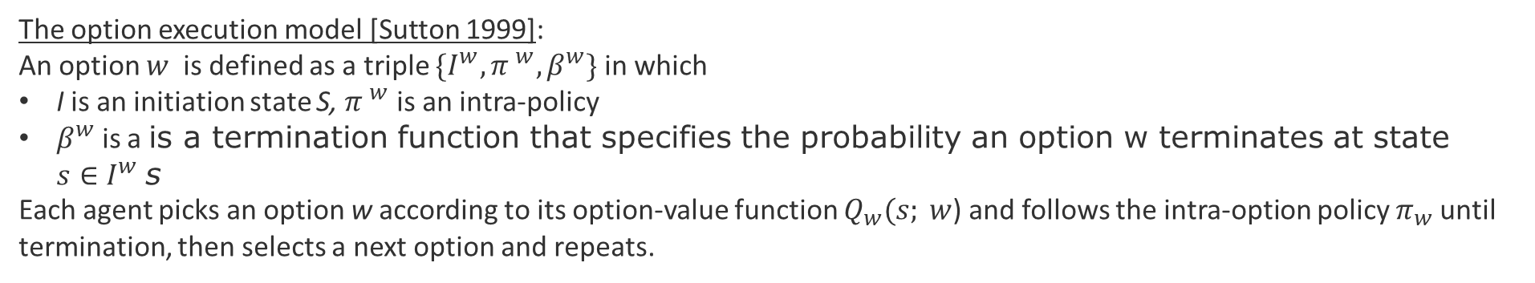
Multi-Agent Transfer Learning Framework [Yang 2020]
The option execution model [Sutton 1999]:
An option $w$ is defined as a triple $\{I^{w}, {π }^{w},β^{w}\}$ in which
I is an initiation state S, ${π }^{w}$ is an intra-policy
$β^{w}$ is a is a termination function that specifies the probability an option w terminates at state ${s∈I}^{w}$s
Each agent picks an option w according to its option-value function $Q_{w}(s; w$) and follows the intra-option policy $π_{w}$until termination, then selects a next option and repeats.
allows agents to imitate each others policy to compute the transfer loss function
T is the length of the trajectory segment in PPO
Yang, T., 2020, Transfer among Agents: An Efficient Multiagent Transfer Learning Framework. arXiv:2002.0803
Sutton R., et al., 1999, Between MDPs and semi-MDPs: A framework for temporal abstraction in reinforcement learning. Artificial Intelligence, 112(1):181– 211
Notes:
Between MDPs and semi-MDPs: A
framework for temporal abstraction in reinforcement learning. Artificial Intelligence, 112(1):181
– 211,

Slide 9
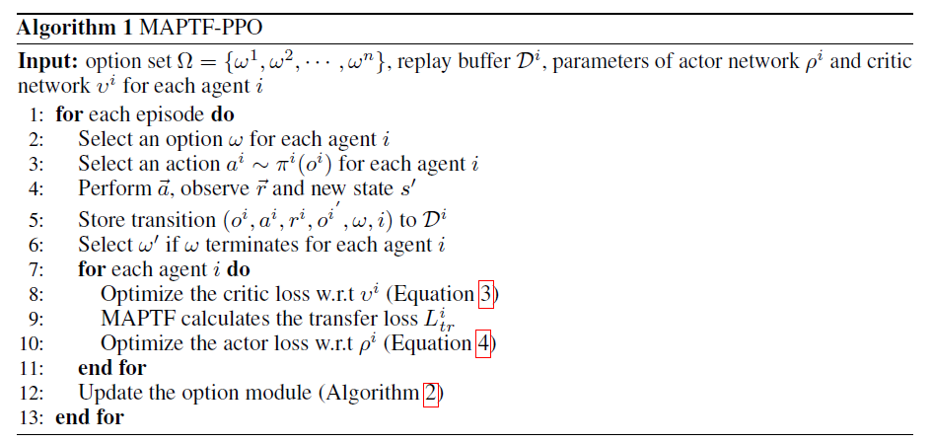
Multi-Agent Transfer Learning Framework [Yang 2020]
Training phase: the option module uses experiences from all agents to update the option-value function and corresponding termination function.
Exploitation: each agent exploits the knowledge from another agent (policy imitation) based on the selected option w. This serves as a complementary optimization objective.
Termination: when the selected option terminates (efficient reuse of knowledge across agents)
source: Yang, T., 2020, Transfer among Agents: An Efficient Multiagent Transfer Learning Framework. arXiv:2002.08030
Notes:
Between MDPs and semi-MDPs: A
framework for temporal abstraction in reinforcement learning. Artificial Intelligence, 112(1):181
– 211,

Slide 10
Design Tasks Transfer Learning in Multi-Agent Reinforcement Learning

Slide 11
POMDP Modeling Challenges
What is an adequate definition of our POMPD (Partially Observable Markov Decision Process)?
What would be the specific difficulties of modeling:
2.1 Discrete actions (restart component), which fix failures CF1, CF2, CF3 via DQN or Double DQN?
2.2 Continuous actions (add/remove instances), which fix the failure CF5 via SAC?
What are the impact of partial observability of failure status with respect to:
3.1 Choice of action (reward modeling)?
3.2 Policy learning (convergence, sample efficiency)?
3.3 Coordination (ranking of actions)?
3.4 Transfer learning (according to different types of perturbations)?
Suggest one more design concern to discuss

Slide 12
Learning Models Challenges
What would be the pros and cons in our scenario by adopting
Model-free (e.g., DQN)
Model-based (e.g., Dyna-Q)
Q-value vs Policy Gradient?
On-policy (A2C,A3C)
Off-line policy (SAC,DQN)
Suggest one more learning model to discuss (e.g., eligibility traces, replay buffer, etc.)

Slide 13
Coordination Challenges
What are the pros and cons in adopting any of the following MARL architectures
Independent Learning Agents
VDN
QMix
VDCA
Suggest on more architecture to discuss.

Slide 14
Transfer Learning Challenges
What type of knowledge can we transfer?
For each type of knowledge, list and briefly discuss:
2.1 The uncertainty in the knowledge
2.2 The impact of these uncertainties
2.2.1 In training/testing (sample efficiency, convergence)
2.2.2 In production (suboptimal utility, loss of robustness)
For each anticipated knowledge transfer shortcoming, list:
3.1 Constraints
3.2 Trade-offs
3.3 Mitigating assumptions
Suggest one more transfer learning concern to discuss

Slide 15
Evaluation metrics challenges
Which of these metrics best capture the quality of the transfer learning solution in our scenario? Assume that the goals are to maximize cumulative system utility and minimize loss of robustness under perturbations are the goal.
Jumpstart performance: the initial performance of the agents.
Asymptotic performance: the ultimate performance of the agents.
Accumulated rewards: the area under the learning curve of the agents.
Transfer ratio: the ratio between asymptotic performance of the agents with transfer learning and asymptotic performance of the agents without transfer learning.
Time to threshold: the learning time (iterations) needed for the target agents to reach certain performance threshold.
Performance with fixed training epochs: the performance achieved by the target agents after a specific number of training iterations.
Performance sensitivity: the variance in returns using different hyper-parameter settings.
Your suggestion of metric?

Slide 16
References

Slide 17
Transfer Learning in MARL – Wednesday May 18
Surveys
Zhu, Z., et al., 2020, Transfer learning in deep reinforcement learning: A survey. arXiv:2009.07888.
Silva, F. L. da & Costa, A. H. R., 2021, Transfer learning for multiagent reinforcement learning systems. Synthesis Lectures on Artificial Intelligence and Machine Learning 15.3, pp.1-129.
Herrera, Manuel, et al., 2020, Multi-agent systems and complex networks: Review and applications in systems engineering. Processes 8.3, 312
Cheng, Z., et al., 2021, Multi‐agent reinforcement learning via knowledge transfer with differentially private noise. International Journal of Intelligent Systems 37.1, pp.799-828.
Christianos, P., et al., 2020, Shared experience actor-critic for multi-agent reinforcement learning. arXiv:2006.07169.
Grimbly, St. , et al., 2021. Causal multi-agent reinforcement learning: review and open problems. arXiv:2111.06721.
Yang, T., et al., 2020, Transfer among agents: an efficient multiagent transfer learning framework. arXiv:2002.08030.
Applications

Slide 18
Further readings MARL
Critiques
Hernandez-Leal, P., et al., 2018, Is multiagent deep reinforcement learning the answer or the question? A brief survey. learning 2122.
Hernandez-Leal, P., et al., 2020, A very condensed survey and critique of multiagent deep reinforcement learning. Proceedings of the 19th International Conference on Autonomous Agents and Multi-Agent Systems.
Gronauer, S. & Diepold, K., 2021, Multi-agent deep reinforcement learning: a survey. Artificial Intelligence Review, pp.1-49.
Vithayathil V., et al., 2020, A survey of multi-task deep reinforcement learning. Electronics 9.9.
Zhang, K., et al., 2021, Multi-agent reinforcement learning: A selective overview of theories and algorithms. Handbook of Reinforcement Learning and Control, pp.321-384.
Nguyen, T. T., et al., 2020, Deep reinforcement learning for multiagent systems: A review of challenges, solutions, and applications. IEEE transactions on cybernetics 50.9, pp.3826-3839.
Du, W. & Ding, S.., 2021, A survey on multi-agent deep reinforcement learning: from the perspective of challenges and applications. Artificial Intelligence Review 54.5, pp.3215-3238.
Rădulescu, Roxana, et al., 2020, Multi-objective multi-agent decision making: a utility-based analysis and survey. Autonomous Agents and Multi-Agent Systems 34.1, pp.1-52.
Zafar, H., et al., 2021, Transfer Learning in multi-agent reinforcement learning with double Q-Networks for distributed resource sharing in V2X Communication. arXiv:2107.06195.
Lopez-Cot, S., 2020, Learning to teach in multiagent reinforcement learning with teams of N> 2 Agents. Diss. Massachusetts Institute of Technology.
Hejazi, E., 2021, Multi-agent machine learning in self-organizing systems. Information Sciences 581, pp.194-214.
Surveys
Applications

Slide 19
Robustness – Adversarial training & Non-Stationarity
van der Heiden, T., et al., 2020, Robust multi-Agent reinforcement learning with social empowerment for coordination and communication. arXiv:2012.08255.
Papoudakis, G., et al., 2019, Dealing with non-stationarity in multi-agent deep reinforcement learning. arXiv:1906.04737.
Zhang, K., et al., 2020, Robust multi-agent reinforcement learning with model uncertainty. NeurIPS.
Moos, Janosch, et al.,2022, Robust Reinforcement Learning: A Review of Foundations and Recent Advances. Machine Learning and Knowledge Extraction 4.1: 276-315.

Slide 20
End

